Slide 1
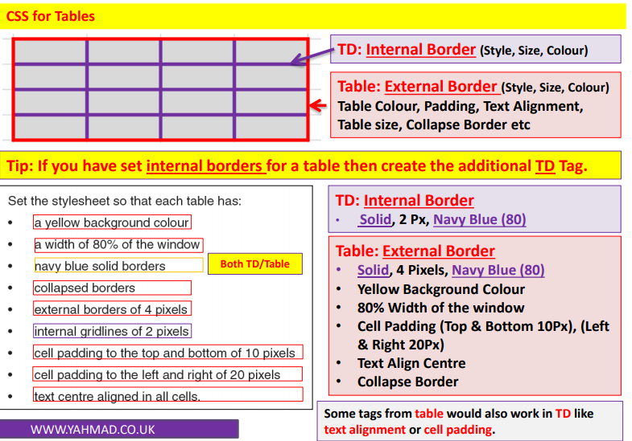
Web Authoring

Slide 2
Web Authoring
Task 1– Set the style sheet so each table has:
Create a new CSS called tablestyle2.CSS
Table CSS
Table | Yellow Background
 | Height: 200px, Width 500px
 | Collapsed Borders
 | External Borders – 4 px, Blue
 | Internal Borders – 1px, Red | TD
 | All Borders Solid
 | Cell Padding to the left and right of 15 px
 | Text right aligned in all cells
Body | Dark Green Background
Set your name as a comment /*Name*/

Slide 3
Web Authoring
Task 2 – Create Table
Create a new html file called Tables2.htm and attach the style sheet created in step 1. Create the tables shown below and apply appropriate labels.
Table 1
Table 2

